Slide 1
IMAGINE YOUR STORY
Summer Challenge at the Fletcher Free Library!
Registration starts June 15!

Slide 2
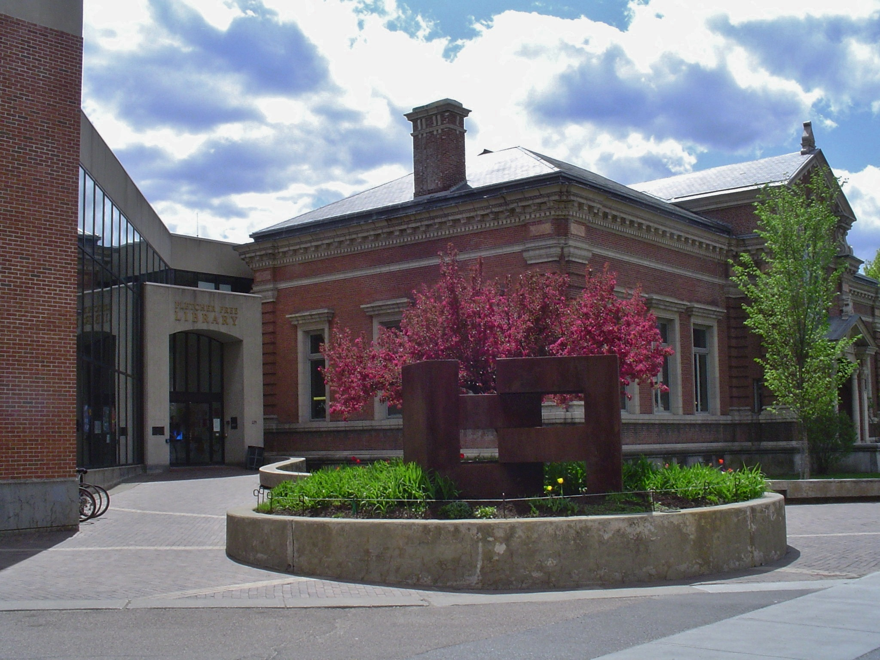
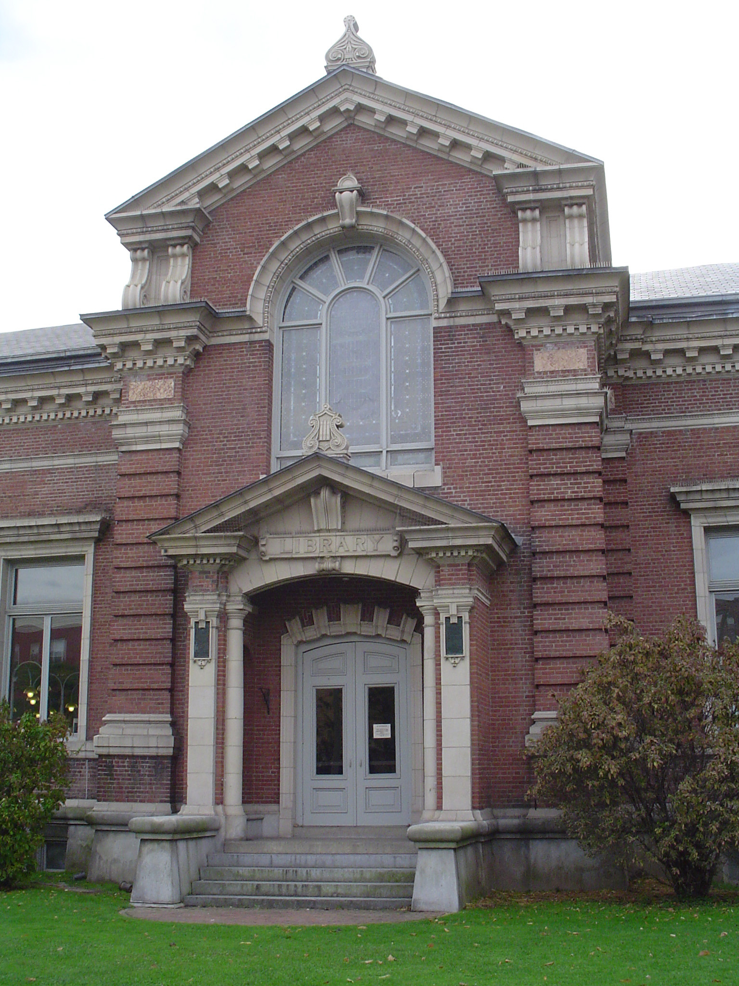
235 College Street, Burlington

Slide 3
Visit fletcherfree.org to
Find information about the Summer Challenge
Complete fun activities, including scavenger hunts, math challenges & more
Enjoy virtual library programming
Place books and other items on hold, read ebooks and listen to eaudio, watch streaming video through Kanopy and Hoopla
READ
SHARE
EXPLORE
PLAY
LEARN
with Fletcher Free Library this summer!
Look for library staff at your local meal distribution site!

Slide 4
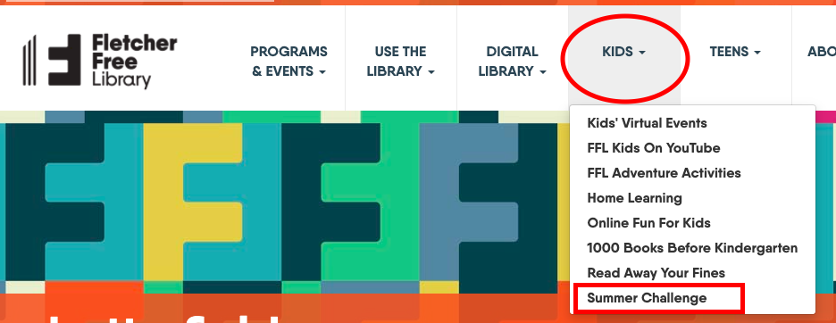
Summer Challenge information is online at fletcherfree.org:
Registration starts June 15!

Slide 5
Your Activity Log!

Slide 6
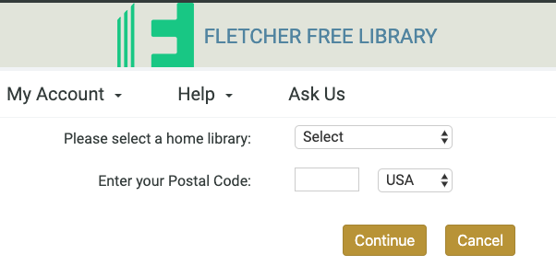
Get a library card online!
Visit fletcherfree.org/GetALibraryCard
Click “Register online today.”
Follow the prompts to create your card.
Can’t find your card?
Call 802.863.3403
or email circ@burlingtonvt.gov

Slide 7
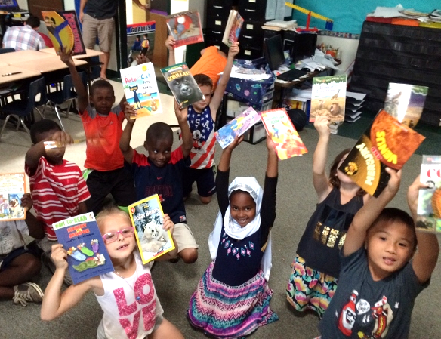
Look for library staff at your local meal distribution sites:
Franklin Square, Riverside,
Roosevelt Park, South Meadow
& more

Slide 8
